Slide 1



Slide 2
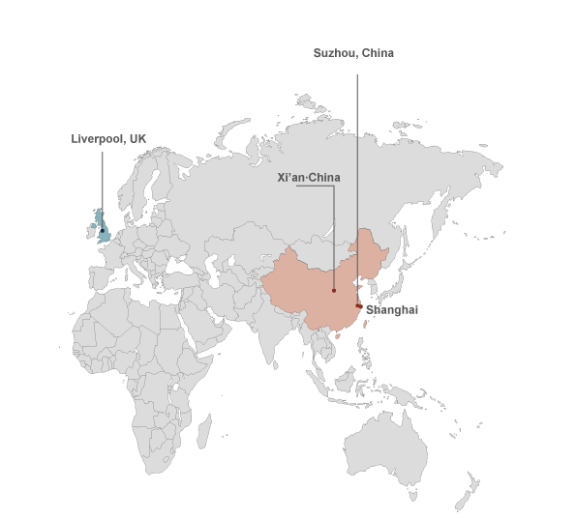

Xi’an Jiaotong Liverpool University（XJTLU)
西交利物浦大学（西浦）
UoL
XJTU
Sept. 2004: Agreement signed
Mid of 2006: Licenced by MoE(Ministry of Education)，160 first tier students
9,700 students, >7,000 at XJTLU campus
Programmes: 24 science, engineering, management, social
6th UG cohort graduates this year
3st MSc students graduated in January
3st PhD student graduated in June

Slide 3



XJTLU Model Exploration
大学模式探索
Religion
宗教
Explore XJTLU Model
西交利物浦大学模式探索
Best Western Practice
西方最优实践
Law
法律
学习 &
比较 &融合
Future Trends & Challenges
未来趋势与挑战
Morality
道德
Religion
宗教
Best Eastern Practice
东方最优实践
Science
科学
Art
艺术
Law
法律
Morality
道德
Basis of Western Culture
西方文化的基础
Basis of Eastern Culture东方文化的基础
Science
科学
Art
艺术

Slide 4
Vision
大学愿景
To become a research-led international university in China and a Chinese university recognised internationally, with its unique features in teaching & learning, research, social service, education management.

Slide 5
Distinctive Features 大学特色
The only Sino-Foreign cooperative university in China established by two leading universities in the world and primarily offering degrees in sciences, engineering and business management
The only university in China awarding both British diplomas (Liverpool) and Chinese ones (XJTLU)
An educational philosophy featuring student-development oriented, interest guided and learning centered
Academic staff recruited worldwide and learning & teaching environment internationalised
English serves as the language of instruction for all subject courses
International teaching quality assurance and monitoring systems
A student management system regarding students autonomy and university support as its core
A four-tutor system including the class tutor, internal tutor, external mentor and the buddy system

Slide 6
Five-Star Education Model
创新型“五星育人模式”
人类管理的智慧
Wisdom of Human
Management
中西文化比较与融合
Comparison &
Integration of Culture
中西教育比较与融合
Comparison &
Integration of Education
挑战与未来趋势
Challenges and
Future Trend
Philosophy & Value System
Capability System
Education Goals
Global Citizen
Knowledge System
Comprehensive
Education Strategy
Support Systems
of Implementation

Slide 7
Five-Star Education Model
创新型“五星育人模式”
Reflection on the Foundation Year
基础年的思考
From kids to young adults to global citizen
从孩子到年轻成人到世界公民
From passive learner to active leaner to research-led learner
从被动学习到主动学习到研究型学习
From aimless to interest-oriented to life planning
从盲目到兴趣导向到人生规划
Philosophy &
Value
素养
Capability
能力
Knowledge
知识
Self Management & Personal Development
自我管理& 个人发展
Learning Behaviours
学习行为
Experience
体验
MPC 数理教学中心 |  | CCTC 中国文化教学中心
ELC 英语语言中心 | Centre for Information 信息中心 |  | Centre for Student Affairs 学生事务中心
XJTLU Year1 Committee 西交利物浦大学一年级委员会

Slide 8
Application Enterprise Architecture
Desktop
Mobile terminal
Staff
Student
Access Layer
Public
Alumni
XJTLU University Portal(Web 2.0)
Information Portal
Official Website
Student Portal
Staff Portal
Alumni Portal
……
Learning and Teaching
Business Service
Library
Research
Business Application
Virtual Learning (ICE)
HR/ Online Recruitment
E-Book
(CxStar
/Chaoxing)
Student Service (SSP)
Research Project
Student Record System(SITS)
Department Websites
Dissertation submit
Research Accounting
Virtual Class
Digital Library
Research Profile
Timetable
Utalk/Uask
……
……
……
……
Finance
Textbook
Huiwen
Authentication
Authority
Log & Audit
Info Publish
Schedule
Document
Supporting Platform
Instant Message
Workflow
Archive
Report
Search
……
Security /Operation /Maintenance
Data Exchange Centre
Fundamental Service
File Server
AD Account and Email
VPN
DNS
FTP
SMS
Phone System
Hardware/OS
Data Backup
Anti-Virus
Firewall
Monitor system
……
Software Resources
Network
Resources
Server/Storage
Resources
……
Infrastructure
Notes:
In our digital campus contraction plan, the portal (student, staff and alumni) is key part of our application enterprise architecture. We need an information portal to integrate all application into one platform.

Slide 9
Departments, Programmes & Teaching Centres 教学专业系、本科专业与教学中心
系 Departments (12) | 专业 Majors(24)
电子与电气工程系 Electrical & Electronic Engineering | 通信工程 Telecommunications Engineering
 | 电子科学与技术 Electronic Science and Technology
 | 电气工程及其自动化 Electrical Engineering
 | 数字媒体技术 Digital Media Technology
计算机科学与软件工程系 Computer Science & Software Engineering | 计算机科学与技术 Computer Science and Technology
 | 信息与计算科学 Information and Computing Science
工业设计系 Industrial Design | 工业设计 Human Resource Management
生物科学系 Biological Sciences | 生物科学 Biological Sciences
化学系 Chemistry | 应用化学 Applied Chemistry
环境科学系Environmental Science | 环境科学 Environmental Science
数学科学系 Mathematical Sciences | 数学与应用数学 Applied Mathematics
 | 金融数学 Financial Mathematics
商学院 International Business School Suzhou, IBSS | 会计学 Accounting
 | 信息管理与信息系统（电子金融）Information Management and Information Systems
 | 市场营销 Marketing
 | 经济学 Economics
 | 工商管理 Business Administration
 | 人力资源管理 Human Resource Management
 | 公共事业管理（公共卫生） Public Health
英语文化传播系 English, Culture & Communication | 英语 (国际商务英语English and International Business、金融英语English and Finance、传媒英语English and Communication Studies 、应用英语研究Applied English Studies)
 | 传播学 Communication Studies
土木工程系 Civil Engineering | 土木工程 Civil Engineering
城市规划系Urban Planning and Design | 城市规划 Civic Design
建筑系 Architecture | 建筑学 Architecture
教学中心Teaching Centres (4)
语言中心 Language Centre
数理教学中心Mathematics and Physics Centre
中国文化教学中心Chinese Cultural Teaching Centre
体育教学中心Physical Education Centre

Slide 10
Graduates situation: from ordinary to extraordinary
Year | 2010 | 2011 | 2012 | 2013
Further Education | 130 | 460 | 532 | 738
Employment | 6 | 53 | 117 | 143
Total | 136 | 513 | 649 | 881
Around 90% entered world class universities to continue postgraduate studies. 90%左右进入国际大学继续硕士和博士研究生学习
10-15% entered the world top10 universities. 10-15% 全世界排名前十的大学
More than 50% entered the world top 100 universities. 50%以上进入全世界排名前100的大学
Around 10% entered market and many of the graduates are employed by the world 500 companies. 直接就业者部分进入世界500强
Imperial College (EEE) announced: For Chinese applicants studying in China, only consider applications from students studying: C9 or 985, or XJTLU. 英国帝国理工EEE招生：C9 or 985, or XJTLU

Slide 11
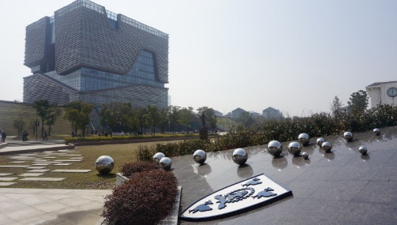
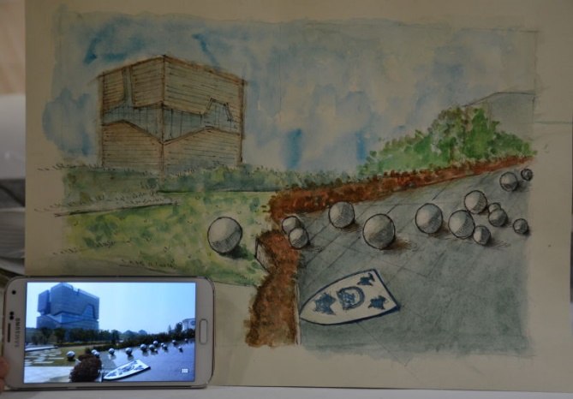
Goal

Slide 12
The Future of XJTLU
Undergraduates
In future XJTLU will have over 15,000 registered students, among which more than 2,000 will be oversea students and several hundreds are students.
Postgraduates
We created postgraduate school in 2012 and plan to have over 2,000 postgraduate.
Research and Service
XJTLU is building around 30 characteristic and research-led academic subjects, around 10 world class research institutes or centers, and TTC, training center through collaboration with governments and industrial sector.
Staff
In future, XJTLU will have 700 academic staff and 300 support staff.
Campus and Facilities
Besides north campus, the construction of South campus started at the end of 2012. Near 100,000 sq.m new building and facilities will be ready at the end of 2016-7 in succession.

Slide 13
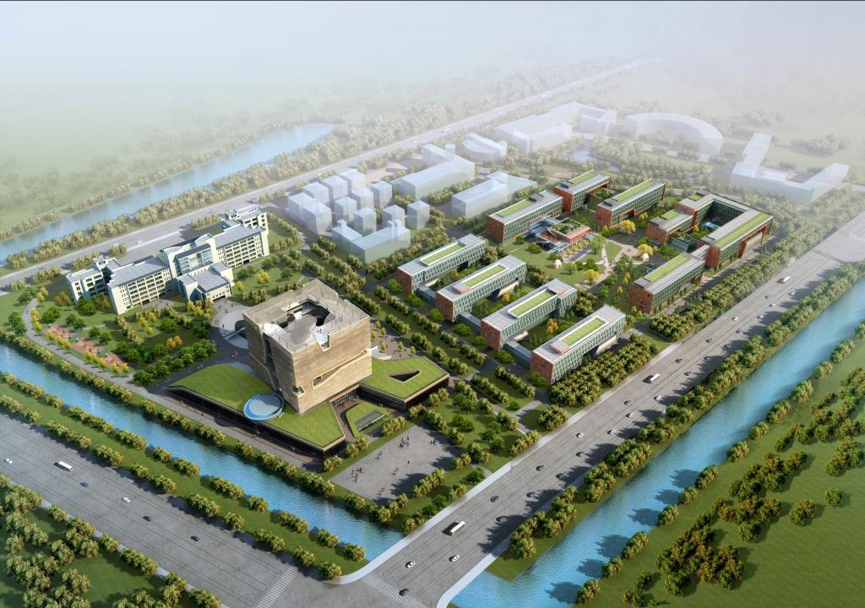
XJTLU North Campus 西交利物浦大学北校园
Student Dormitory
学生宿舍区
Culture Plaza
文化广场
Scholar’s Garden
教师公寓
Sports Field
体育场地
Library
图书馆
Public Security & Service
公共安全和服务
Cinema &
Palaestra
电影院、体育馆

Slide 14
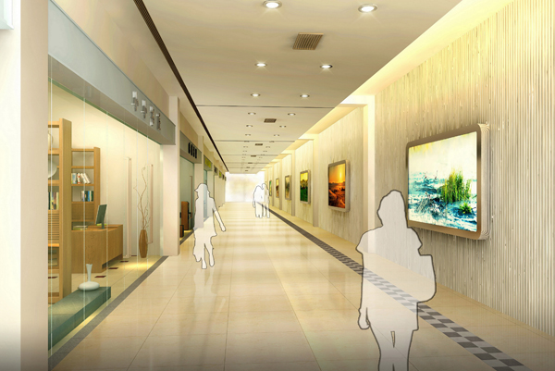
Tunnel from North to South campus 北校区到南校区隧道

Slide 15
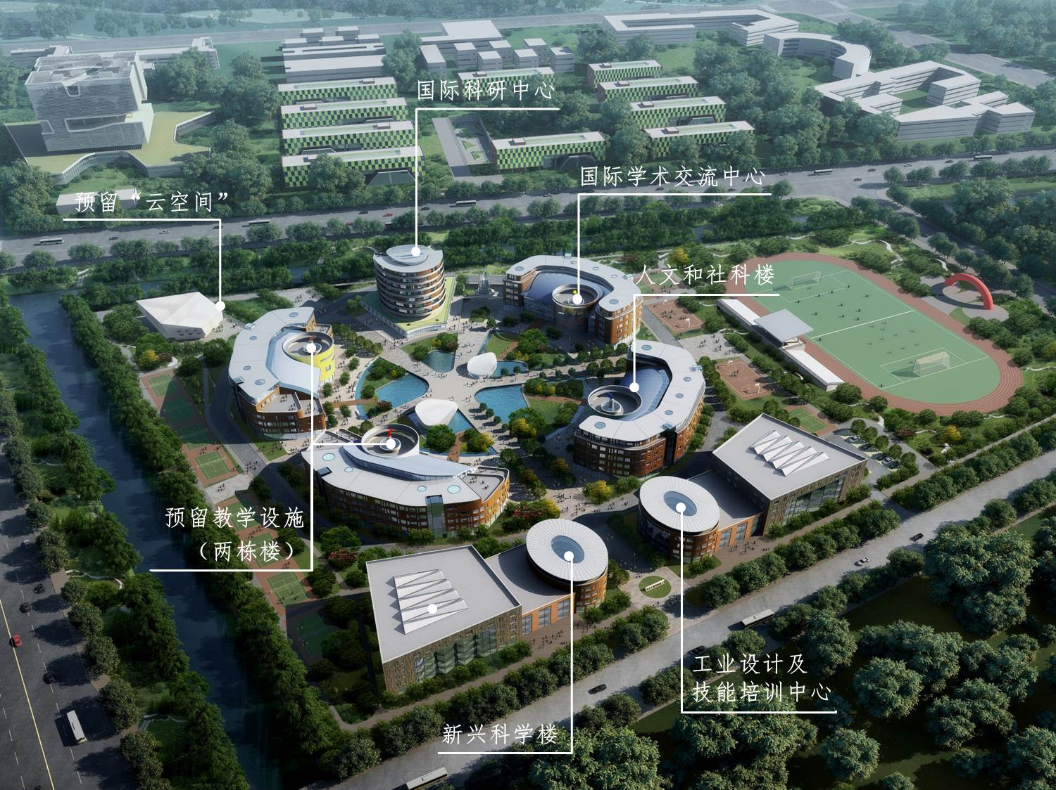
XJTLU South Campus 西交利物浦大学南校园

Slide 16
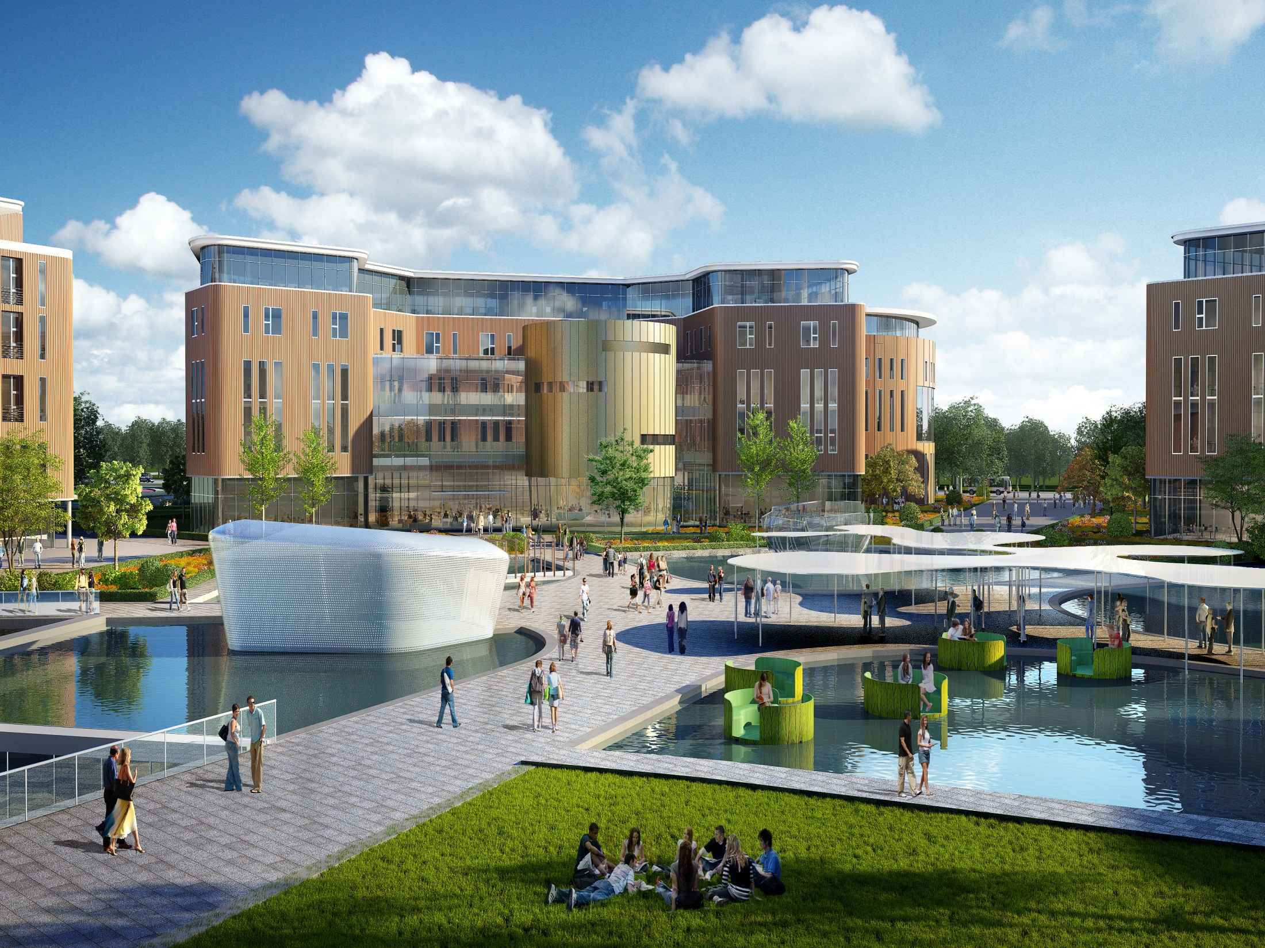
Exterior Picture of South Campus
南校区外景图

Slide 17
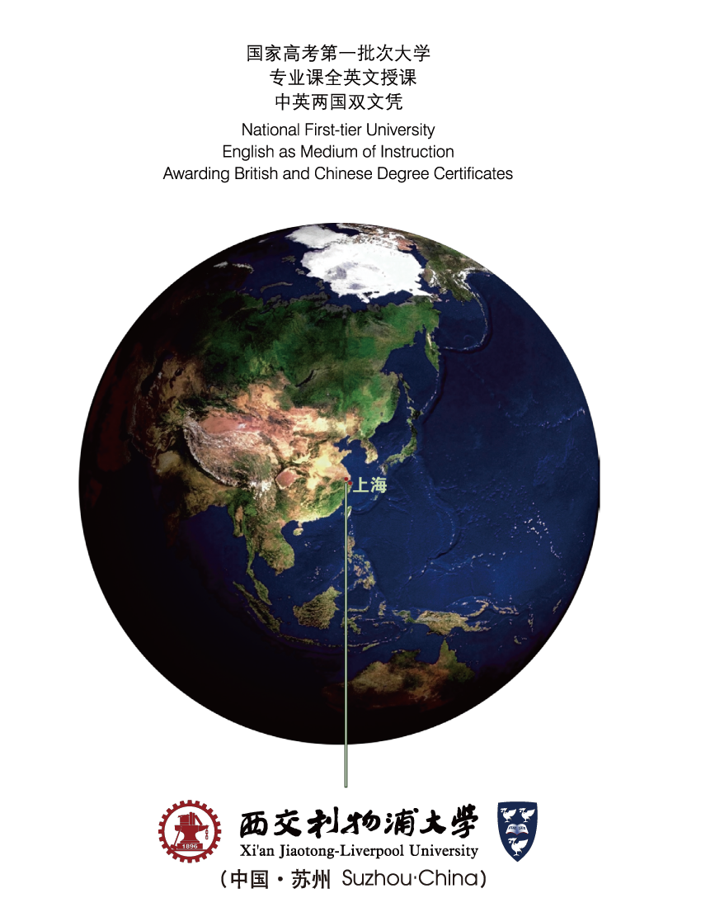

Thank You !

